Slide 1

Center for Business Tendency Studies
The digital activity of Russian enterprises: the first results of pilot surveys
Liudmila Kitrar, Inna Lola
9th JOINT EC/OECD WORKSHOP ON RECENT DEVELOPMENTS IN BUSINESS AND CONSUMER SURVEYS

Slide 2

Content
Motivation and background
Methodology – indicators system, sampling
The results of the first pilot survey in manufacturing
        levels and changes of digital activity
        expected benefits and limitations
        digital technologies in industries with different technological level
Innovations in the pilot surveys in 2019

Slide 3
Motivation and background
The lack of information on the digitalisation of the economy and society has a negative effect on the ability of a country to use all the opportunities offered by digital development
In Russia, the official statistical evaluation of IT in business was launched in 2010 but it is still limited to monitoring first wave technologies: computerisation, process automation and telecommunications. Among the technologies of second and third waves Russian statistics covers cloud computing only
No information on
        sectoral limitations
        usage of IT at the level of specific industries
        dividends on investment in digital technology
Our aim - to compensate for the insufficiency of statistical information by collecting and summarising entrepreneurial opinions and intentions regarding emerging digital technologies, short and medium prospects in the digital economy, the potential benefits of introducing new digital solutions

Slide 4
Sampling and programme
Survey of business tendencies and digital activity in manufacturing
The sample covered 1150 companies
Survey of business tendencies and digital activity in retail trade
The sample covered 700 firms
The first pilot surveys were conducted in mid-2018, the second – in mid-2019
The survey programme is based on international experience in measuring digital progress:
        EC practice in digital agenda and conducting annual surveys of the information society
        European Digital Economy and Society Index (DESI) – key blocks, construction methodology and results analysis
        National state programmes ‘Digital Economy of the Russian Federation’ and ‘Information Society Development Strategy in the Russian Federation for 2017-2030’

Slide 5
Criteria for indicators selection
Surveys indicators are supposed to be:
  consistent with the methodology of BTS conducted over the past 20 years in Russia and reflect the level and main trends in digital activities
  simple, recognisable and understandable to respondents and users
  formulated in line with national quantitative analogues and targets of programs for the development of the digital economy
  as close as possible to international counterparts
  all information is of a qualitative nature

Slide 6
The indicator system
Performance indicators: key trends characterising the business climate
Digital manufacturing market: the stage of digital development, the current and expected levels of digitalisation, the impact of digital technologies on production, the availability of a strategy for digital technology development
The level of digital technologies implementation
Dividends on investment in digital technology
Human resources/digital skills
Main limiting factors

Slide 7
Technology classification
Classification of manufacturing industries by the level of technology
Medium- and high-tech production |  | Low-tech production
CH | Manufacture of chemicals and chemical products | T | Manufacture of textiles
PH | Manufacture of basic pharmaceutical products and pharmaceutical preparations | W | Manufacture of wearing apparel
C | Manufacture of computers, electronic and optical equipment | L | Manufacture of leather and leather products
E | Manufacture of electrical equipment | C&RP | Manufacture of coke and refined petroleum products
M&E | Manufacture of machinery and equipment not elsewhere classified | R&P | Manufacture of rubber and plastic products
M | Manufacture of motor vehicles, trailers and semi-trailers | BM | Manufacture of basic metals
 |  | FM | Manufacture of fabricated metal products, except machinery and equipment
 |  | F | Manufacture of furniture
The classification was developed by UNIDO and recommended for use in the CIS countries

Slide 8
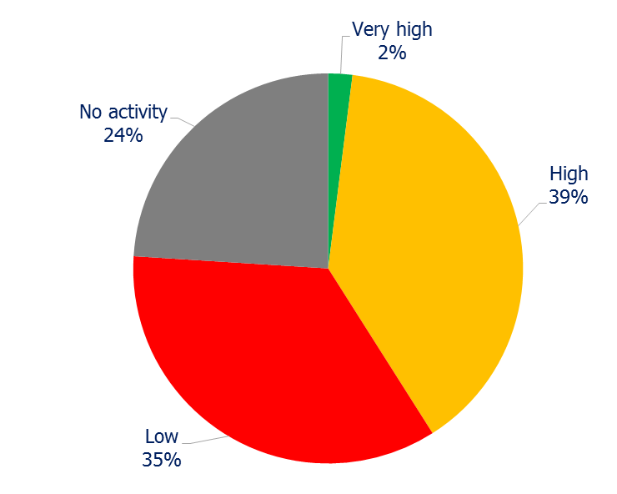
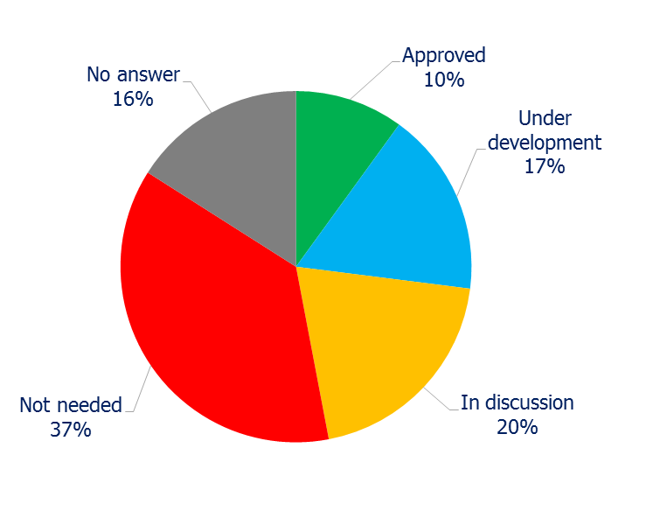
Results: digital activity
Digital activity
Digital strategy
the share of respondents who mentioned each position, %

Slide 9
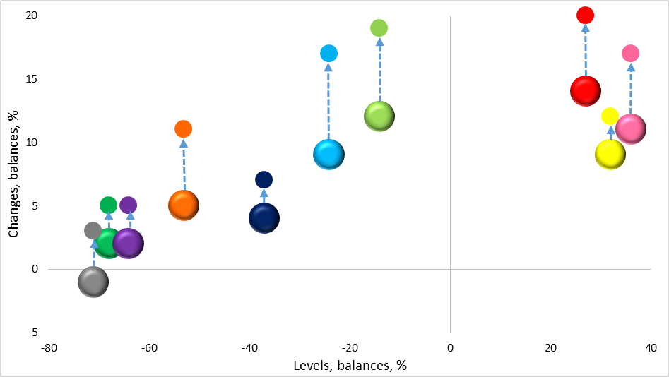
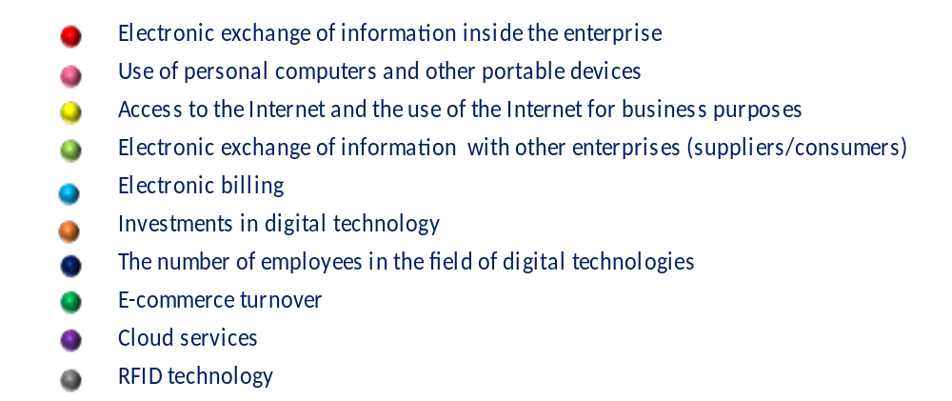
Results: the levels and changes of digital activities
Digital activities:
The modest positive trends in the digital activity indicators
The bigger markers represent current changes in the first half of 2018, the smaller markers – expectations for the first half of 2019

Slide 10
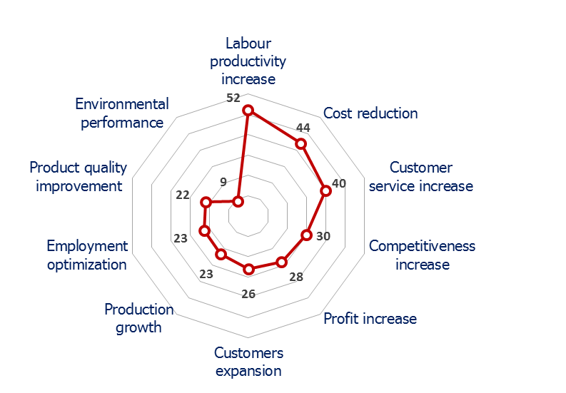
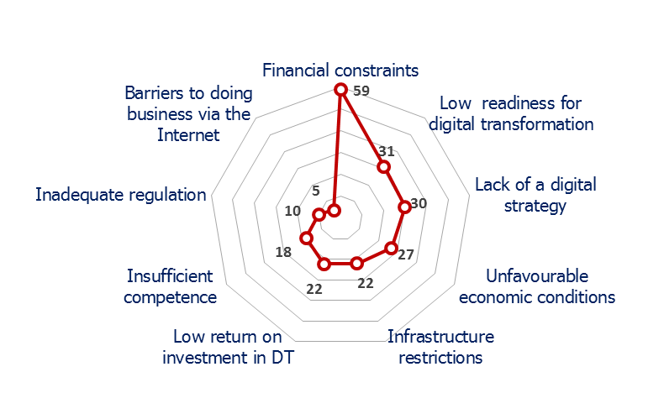
Results: benefits and limiting factors
The expected benefits of investment in digital technology
Factors limiting the digital transformation
the share of respondents who mentioned each position, %

Slide 11
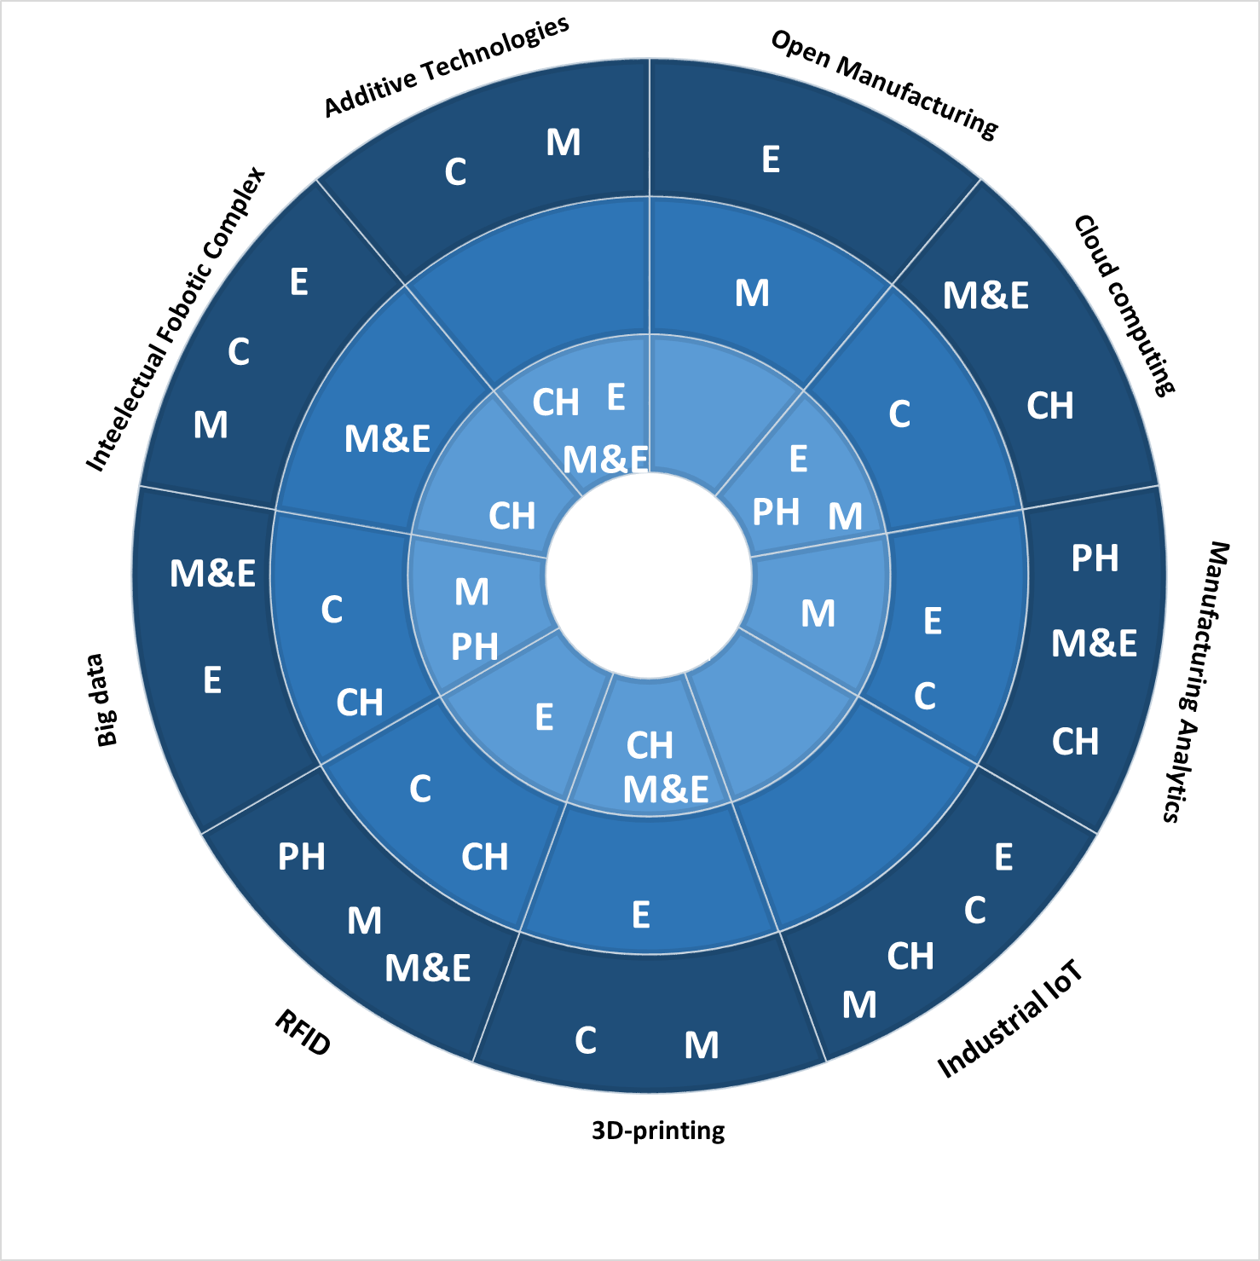
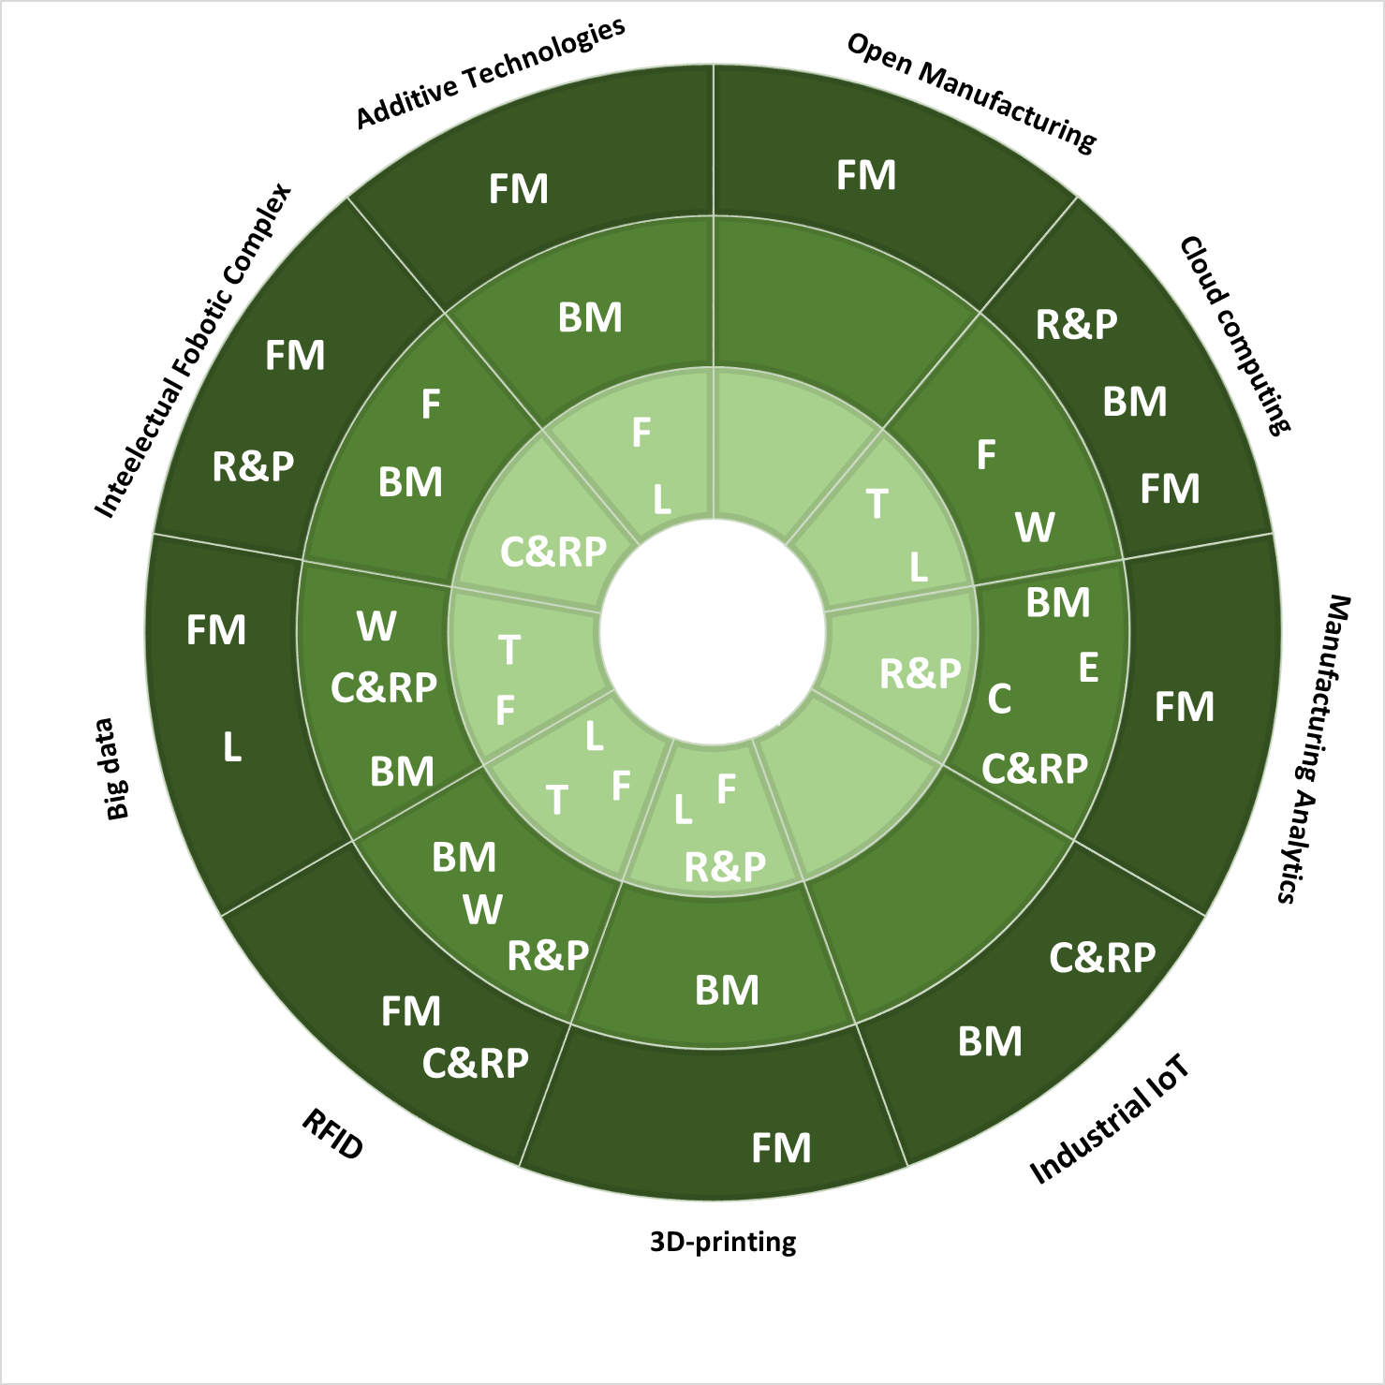
Results: digital technologies in various industries.
Medium and high-tech industries (MHT)
C – Computers, electronic equipment
E – Electrical equipment
M – Motor vehicles
M&E – Machinery & Equipment
CH – Chemicals
PH – Pharmaceutical
T – Textiles
W – Wearing apparel
L – Leather products
C&RP – Coke & Refined petroleum
R&P – Rubber & Plastic
BM – Basic metals
FM - Fabricated metal products
F – Furniture
Low-tech industries (LT)

Slide 12
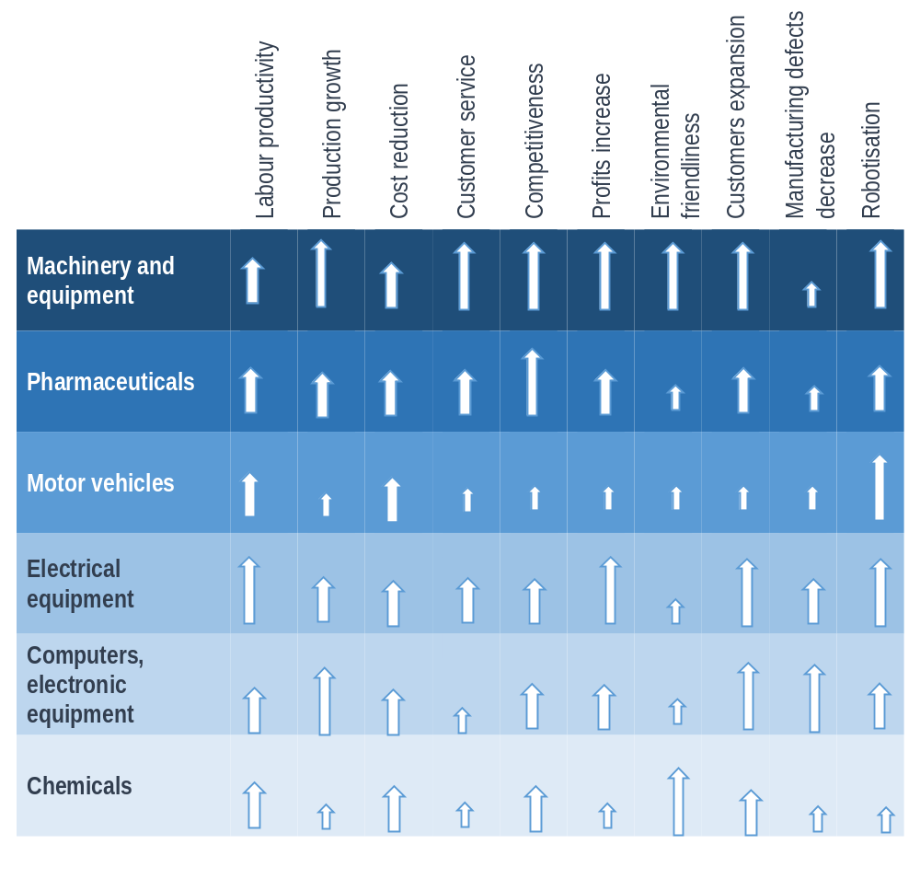
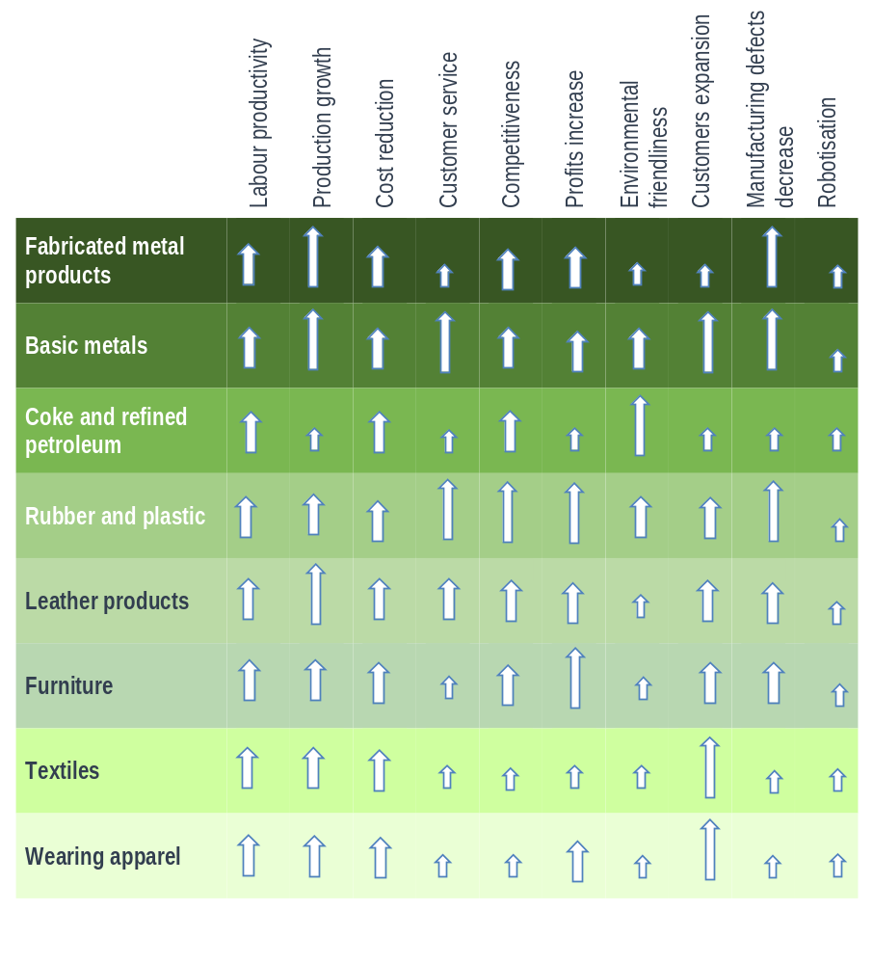
Results: expected effects of digital investment
Medium and high-tech industries (MHT)
Low-tech industries (LT)
The benefits mentioned by a relatively larger share of respondents are recognized as more significant (a long arrow), a relatively medium share – moderately significant (a middle length arrow), a relatively small share – less significant (a short arrow)

Slide 13
First pilot survey in manufacturing: Conclusions
Many projects on digital transformation were in the development stage and required investment
Most of the digital activity indicators showed modest positive trends
The following IT areas were developed successfully:
        the use of personal computers and portable devices
        Internet access and Internet use for business purposes
        electronic information exchange
Digitalisation was constrained by weak investment activity
The main expected benefits from investments in digital technologies:
        increase in productivity and competitiveness
        costs reduction
Industrial IoT, intellectual robotic systems and manufacturing analytics are most common in the MHT industries

Slide 14
Innovations in the pilot survey-2019: Greening.
The experimental set of questions about the use of digital technologies in enterprises for the sustainable inclusive green growth:
Does your company use digital technologies to increase environmental and resource efficiency in the region in the following areas:
        improving energy efficiency
        creating clean and safe energy
        improving the efficiency of water and raw materials
        increasing carbon efficiency
        reduction of greenhouse gas and pollutant emissions
        transition to renewable energy sources
        recycling
        expansion of the electric vehicle fleet
The set of questions is experimental and will be revised after obtaining the results of the pilot survey

Slide 15
Innovations in the pilot survey-2020: Composite indicators.
Experimental composite indicators summarising the qualitative information:
Digital Climate Index is the average of the respondents’ opinions on the levels and tendencies (current and expected) of demand for digital technologies, labour productivity, firms’ competitiveness, economic situation, and the number of employees. The weighted normalised sum of these indices for various economic activities will reflect the dynamics of aggregate digital sentiment of business in Russia
Digital Accessibility Index is the arithmetic mean of the assessments of usage (in levels) and/or expected implementation of all digital technologies listed in the questionnaire
Digital Dividends Index combines estimates regarding the level of dividends
The combination of these three indices will allow us to rank the manufacturing activities with a different technological level and identify digital inequality between industries
All survey programs and procedures for information aggregation are experimental; they will be tested and confirmed or modified for the final selection of relevant composite indicators

Slide 16
Thank you for your attention!
tlipkind@hse.ru

